Slide 1

Rental Market Analysis Using
Web Scraping & EDA
Presented By :- Milind Bagad

Slide 2
About Me
Hello, I am Milind Suresh Bagad.
I have completed my bachelors degree in computer Application (BCA).
I’m interested in Data Science because I enjoy working with data, finding patterns, and solving real problems. I enjoy learning new things, improving my skills, and working on projects that make a difference.
Project :-
Grocery Store Analysis using SQL.
Linkedin : https://www.linkedin.com/in/milind-bagad-82786a224
GitHub : https://github.com/Milind5

Slide 3
Objective Of The Project
1. To build a structured rental dataset using web scraping
Extract real-time property information from websites because no clean dataset exists publicly.
2. To clean, preprocess, and standardize the scraped data
Convert raw, inconsistent text (rent, area, furnishing, floor, BHK) into usable numeric and categorical fields.
3. To analyze rental patterns using Exploratory Data Analysis (EDA)
Study distributions, trends, correlations, and locality-wise variations in rent.
4. To identify key factors that influence rental pricing
Understand the impact of BHK, carpet area, locality, city, floor number, and furnishing on rent.
5. To generate actionable insights for decision-making
Help tenants, owners, and real-estate stakeholders make fair, data-driven rental choices.

Slide 4
Web Scraping Process
Choose Target Website
Import necessary libraries
(BeautifulSoup, Requests)
Scrap the Required Data
Store Data in DataFrame

Slide 5
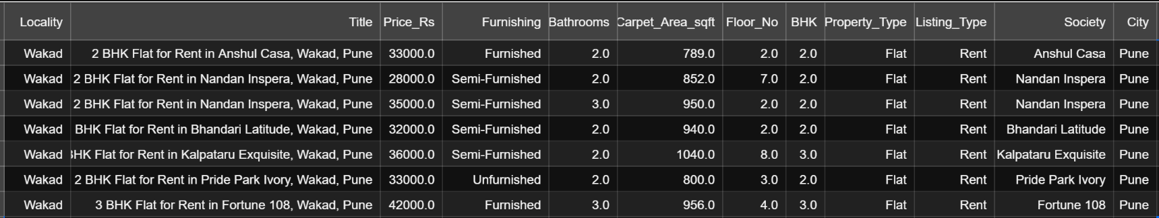
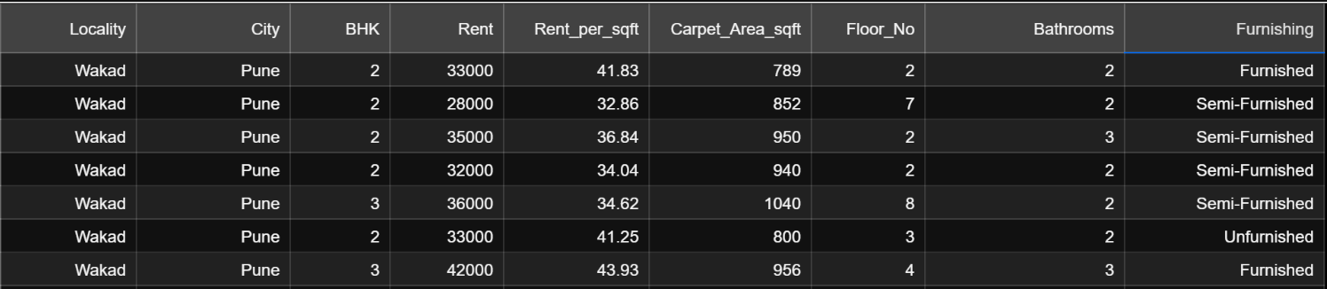
Data Before Cleaning
Data After Cleaning

Slide 6
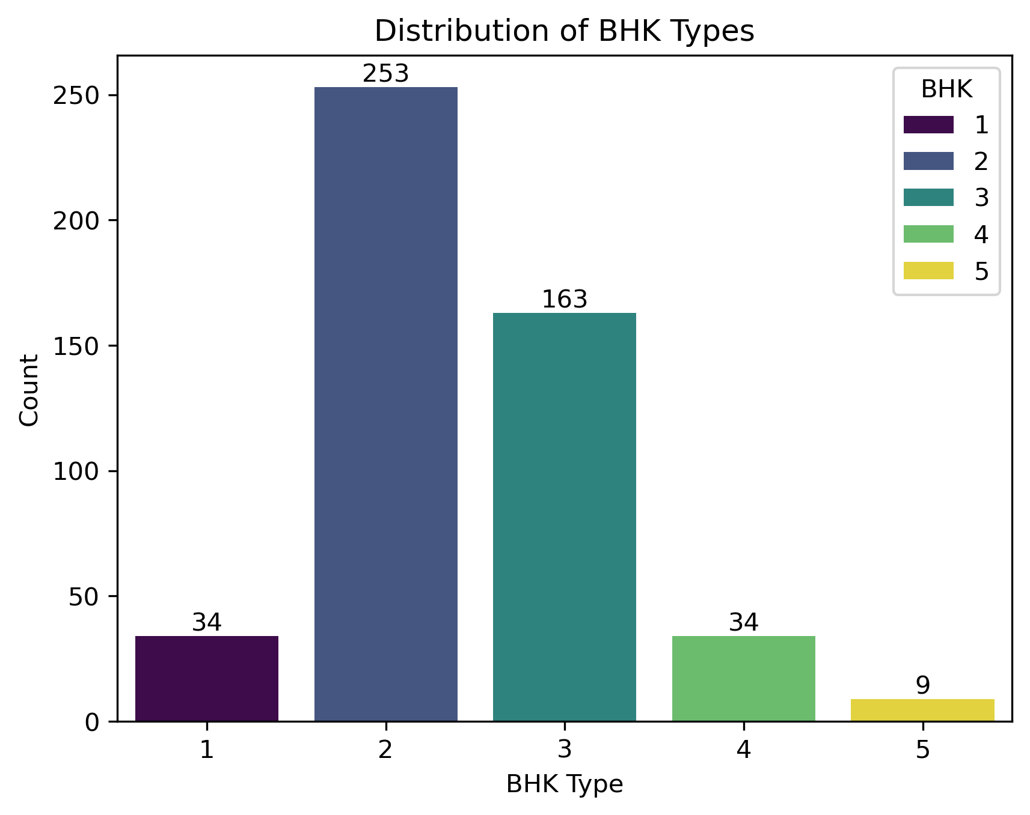
Distribution Of BHK Types
2 BHK flats are the most available in the dataset. 253 listings
1 BHK and 4 BHK flats are limited. 34 listings
3 BHK has the second-highest availability. 163 listings
5 BHK flats are very rare, indicating low supply in the luxury segment. 9 listings

Slide 7
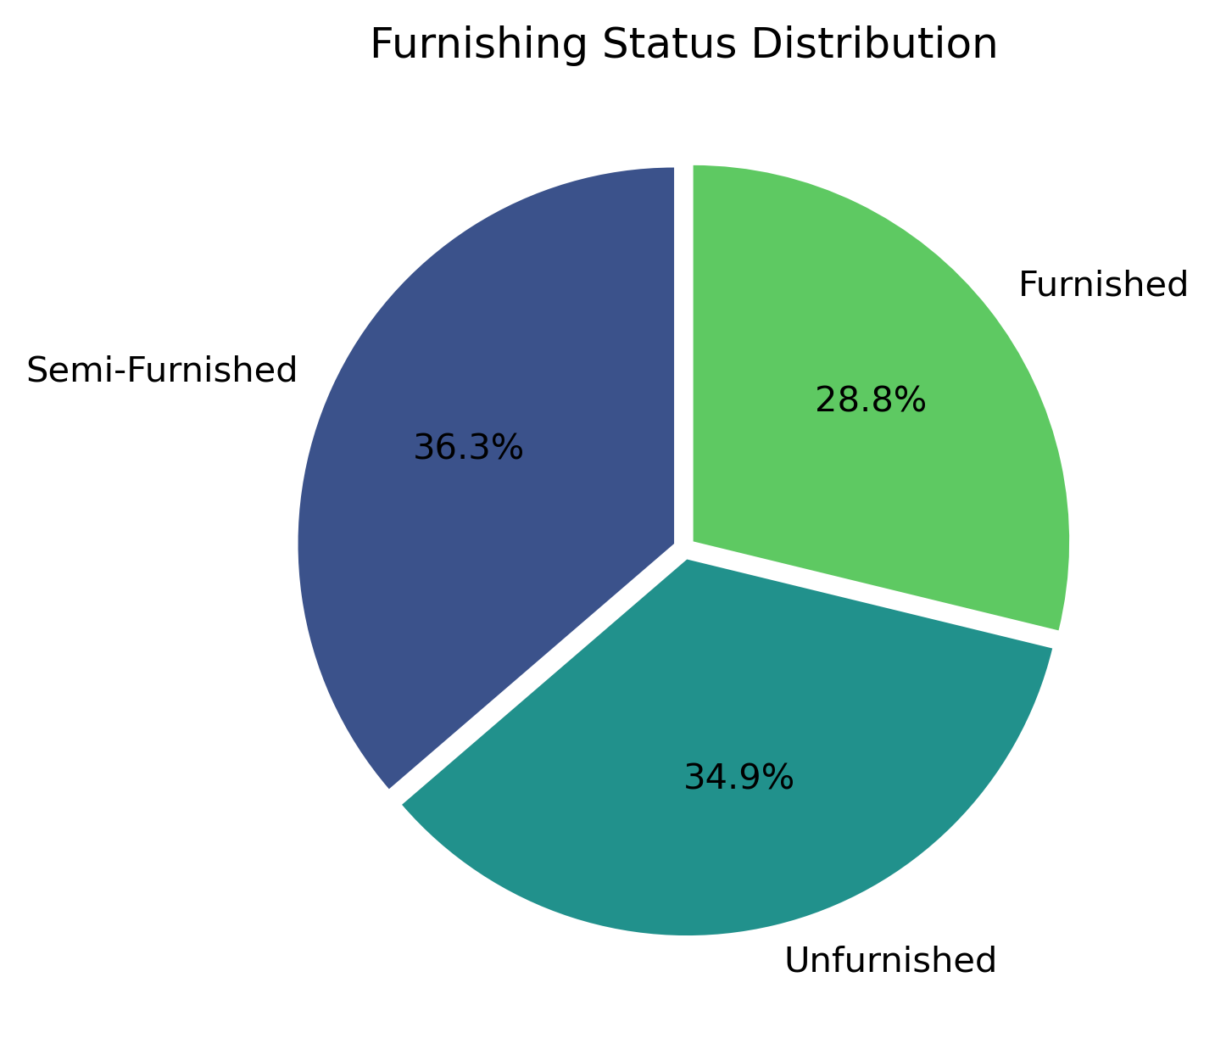
Furnishing Status Distribution
Semi-Furnished flats are the highest (36.3%) in the dataset.
Unfurnished flats come next (34.9%), almost equal to semi-furnished.
Furnished flats are the lowest (28.8%), showing they are less commonly available.
The distribution is fairly balanced, with no category dominating extremely, suggesting diverse renter preferences.

Slide 8
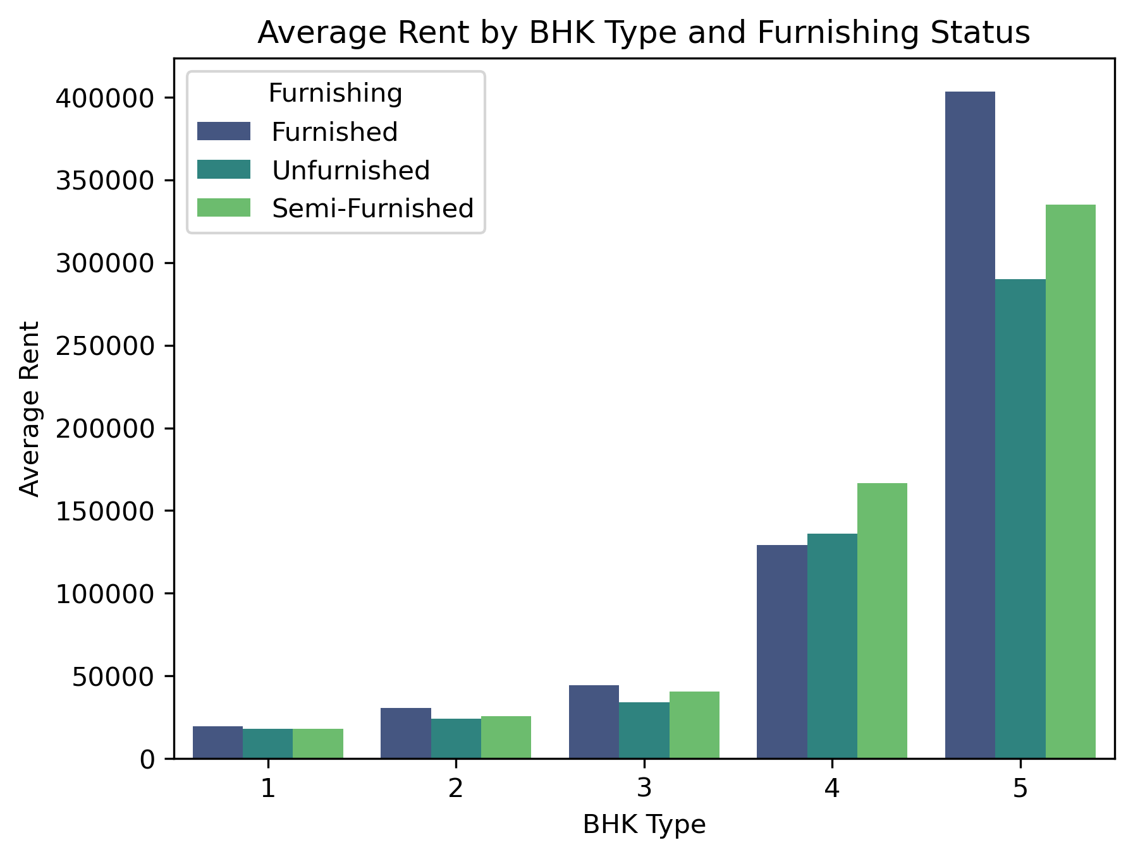
Average Rent by Furnishing
Rent increases sharply as BHK count increases.
For every BHK category, Furnished flats have the highest rent, followed by Semi-Furnished.
Unfurnished flats consistently have the lowest rent across all BHK types.
The gap between furnished vs unfurnished rent becomes very large for 4 BHK and 5 BHK flats — indicating luxury properties charge premium for furnishing.
Furnishing significantly impacts rent, especially in higher-BHK segments.

Slide 9
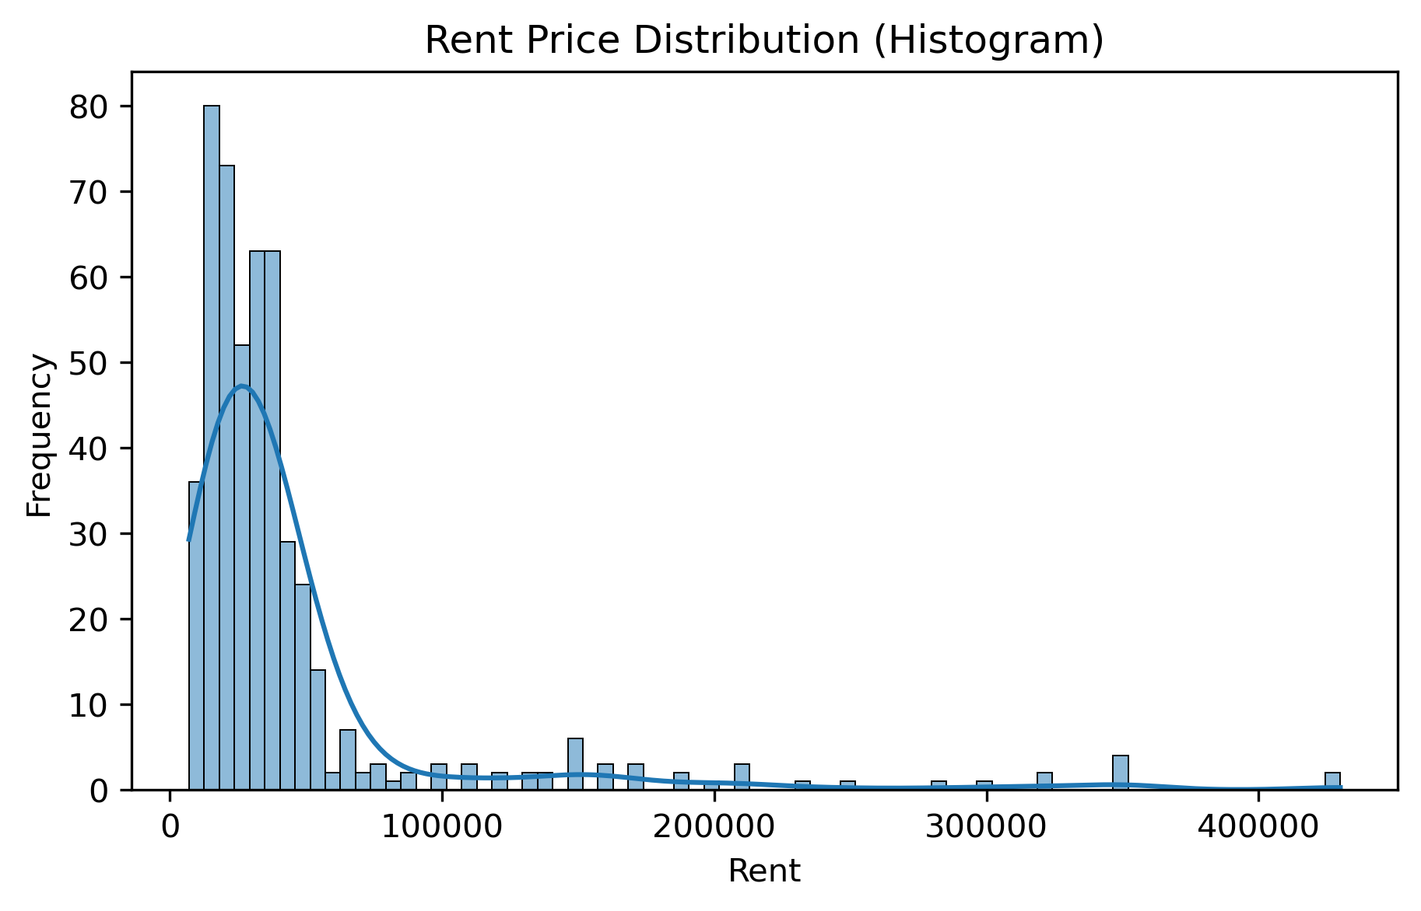
Rent Distribution
Most rental properties fall in the ₹15,000 – ₹40,000 range.
The distribution is right-skewed, meaning a few properties have extremely high rent(₹1,00,000+).
High-rent flats (luxury segment) are rare but significantly pull the average upward.
Majority of flats are affordable to mid-range renters.

Slide 10
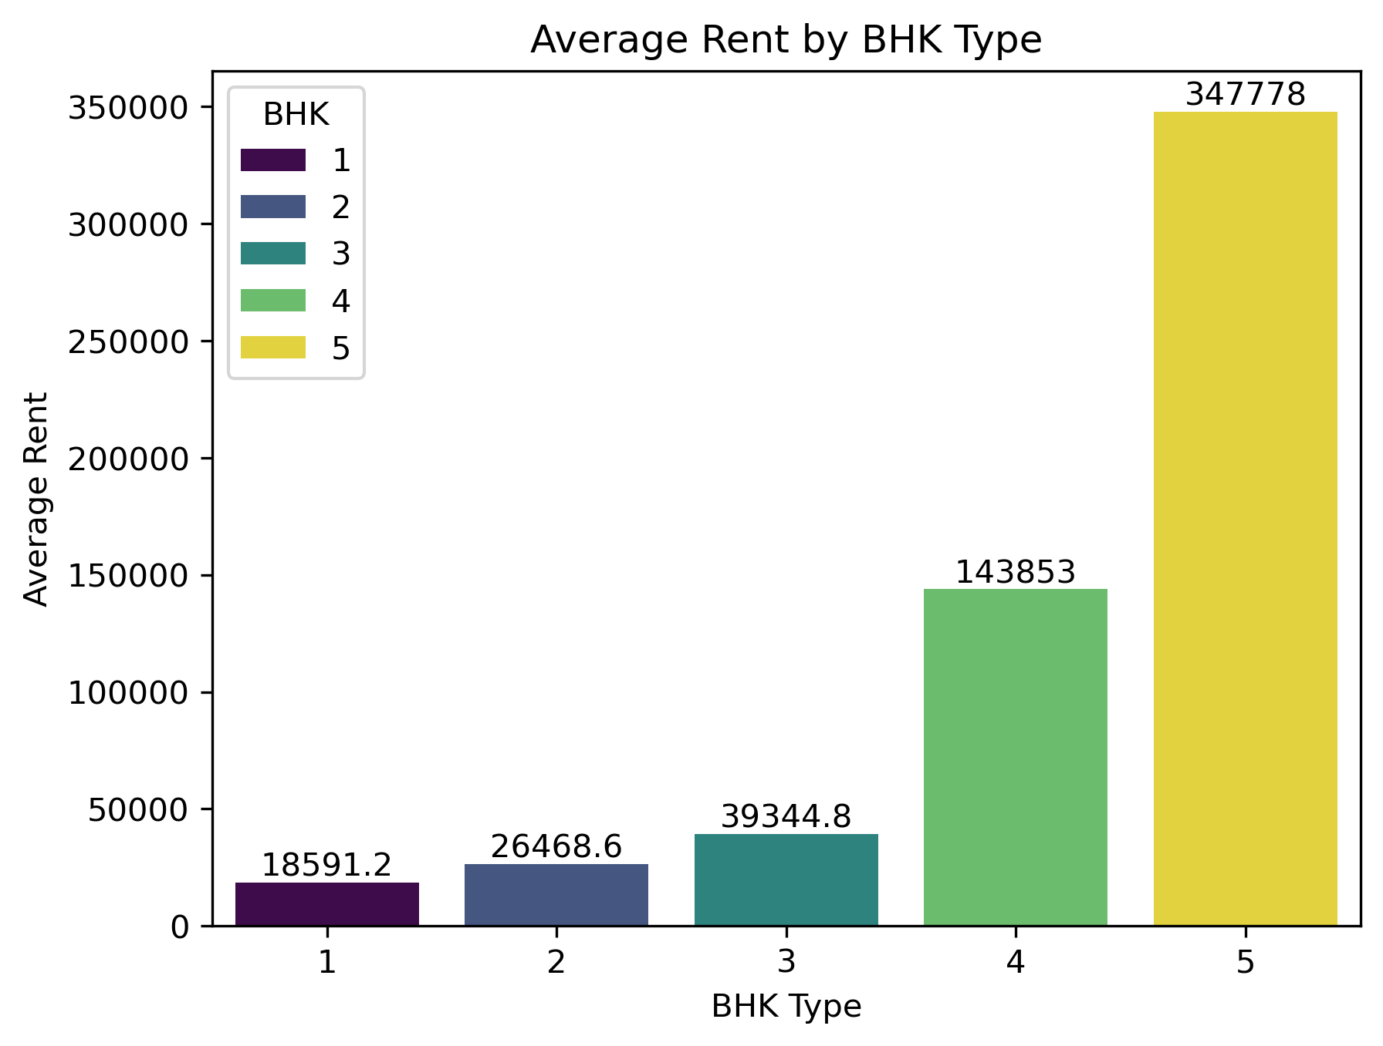
Average Rent by BHK
As BHK increases, the average rent rises sharply.
2 BHK and 3 BHK have moderate rents, widely preferred by families.
4 BHK and especially 5 BHK flats show very high rent, indicating a luxury segment with premium pricing.
The jump from 3 BHK → 4 BHK and 4 BHK → 5 BHK is very steep, showing rent grows exponentially, not linearly, with property size.

Slide 11
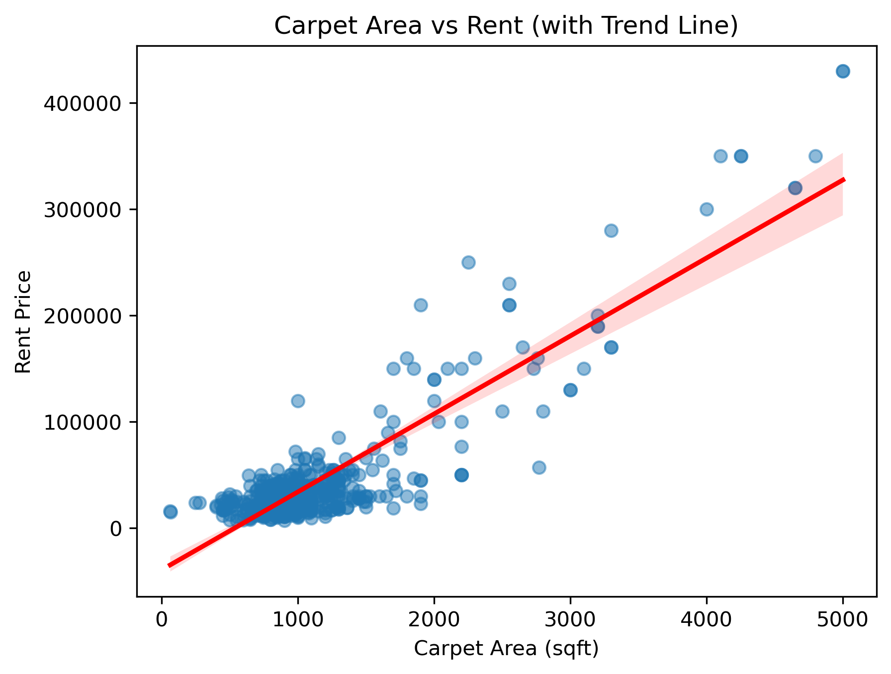
Carpet Area vs Rent
There is a strong positive correlation between carpet area and rent.
As carpet area increases, the rent consistently increases.
Smaller flats (500–1200 sqft) are densely clustered with moderate rent values.
Larger flats (3000+ sqft) show very high rent values, indicating luxury segment pricing.
The trend line confirms a linear upward trend, showing carpet area is a major factor influencing rent.

Slide 12
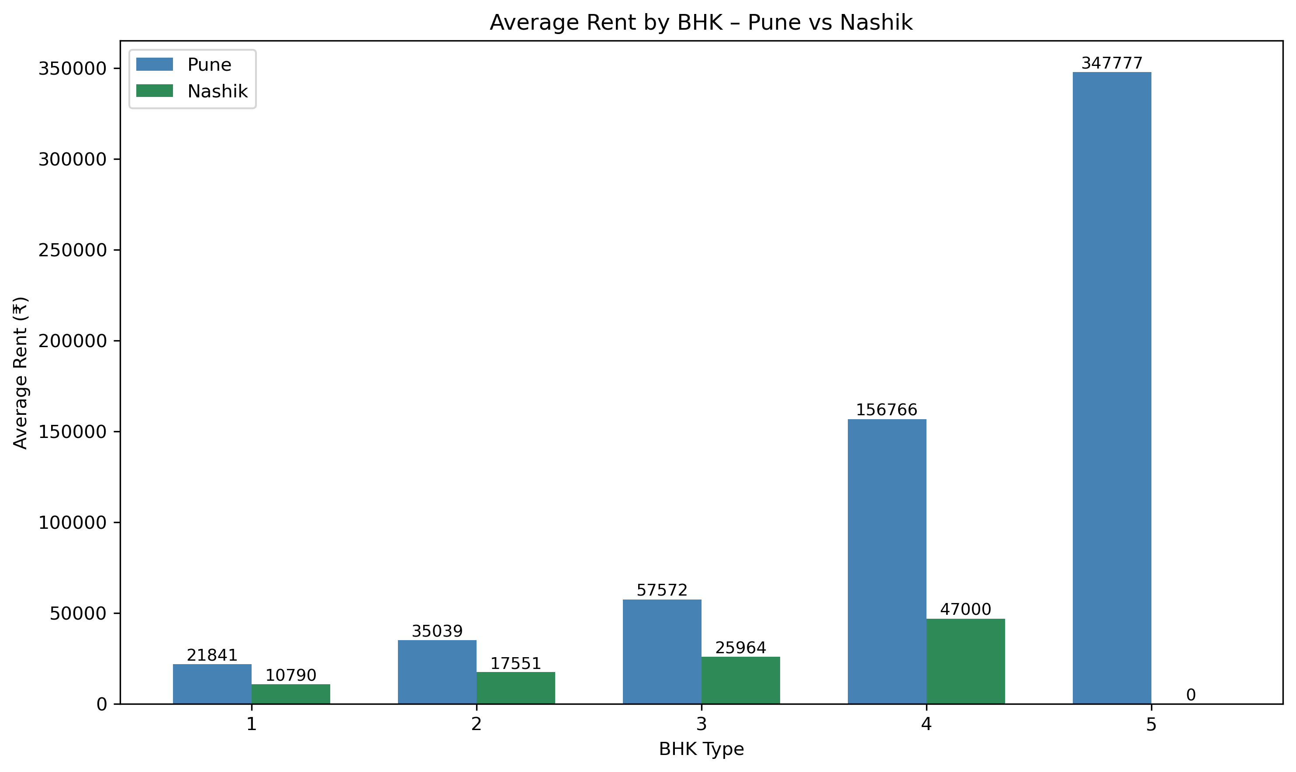
How Rent Changes By BHK Type In Pune vs Nashik
Pune has higher rent across all BHK types — showing a more expensive and competitive market.
Rent gap increases with BHK size
- 1–2 BHK: small gap
- 3–4 BHK: Pune is 2–3× costlier
- 5 BHK: Only Pune has listings (very high rent)
Nashik rents are stable and affordable, with slower rent growth across BHKs.
Pune shows steep price jumps after 3 BHK, indicating luxury and premium apartment availability.
Overall: Pune shows strong rent inflation by BHK, while Nashik remains the budget-friendly option.

Slide 13
Key Insights From Analysis
2 & 3 BHK are the most common rental options.
Most rents fall in the ₹15k–₹40k range.
Rent increases as BHK increases.
Semi-Furnished and Unfurnished flats dominate the market but Furnished flats consistently charge higher rent.
Pune is significantly more expensive than Nashik.

Slide 14
Experience
Extracted real property data from multiple pages and structured it into a usable dataset.
Converted raw text into meaningful features (BHK, area, rent, furnishing, floor).
Discovered how BHK, carpet area, city, and furnishing influence pricing.
Challenges
Had to clean text, remove symbols, fix missing values, and standardize units.
Many features were mixed in one tag, so regex + custom parsing was needed.

Slide 15
Conclusion
1. Successfully scraped and built a structured rental dataset
Converted messy, unorganized website data into a clean and analyzable format.
2. Identified key factors affecting rent
BHK, carpet area, furnishing status, locality, and city significantly influence rental pricing.
3. Clear rental trends and insights were discovered
Most rents fall in the mid-range, 2–3 BHK dominate the market, furnished flats cost more, and Pune’s rent is much higher than Nashik.
4. Analysis helps in better decision-making
The insights can support tenants, owners, and agents in comparing properties and understanding true market value.

Slide 16


